Slide 1
Subject : Mobile Penetration Testing
Year : 2022
Mobile Penetration Testing Standards

Slide 2
Learning Outcomes
At the end of this session, student will be able to:
) Perform Static Analysis and Dynamic Analysis of Android Application
) Identify API and Android Application Vulnerabilities
COMP6047 - Algorithm and Programming

Slide 3
Sub Topics
- Mobile Security Testing Guide (MSTG)
- Using MSTG Checklist
- Mobile Application Security Verification Standard (MASVS)
COMP6047 - Algorithm and Programming

Slide 4
Mobile Application Security Verification Standard
(MASVS)
MASVS is a framework created by OWASP to establish baseline security requirements for mobile apps that are useful in many scenarios.
MASVS is used:
As a metric - To provide a security standard against which existing mobile apps can be compared by developers and application owners.
As guidance - To provide guidance during all phases of mobile app development and testing.
During procurement - To provide a baseline for mobile app security verification.

Slide 5
MASVS Mobile AppSec Model
The Mobile Application Security Verification Standard (MASVS) defines two security verification levels: MASVS-L1 and MASVS-L2
It also contains a set of reverse engineering resiliency requirements named MASVS-R
MASVS-L1 contains generic security requirements that are recommended for all mobile apps
MASVS-L2 should be applied to apps handling highly sensitive data.
MASVS-R covers additional protective controls that can be applied if preventing client-side threats is a design goal.

Slide 6
Fulfilling MASVS Requirement
MASVS-L1
Fulfilling the requirements of MASVS-L1 results in a secure app that follows security best practices and doesn't suffer from common vulnerabilities.
MASVS-L2
Fulfilling MASVS-L2 adds additional defense-in-depth controls for the application to be resilient against more sophisticated attacks
MASVS-R
Fulfilling all, or subsets of the MASVS-R helps impede specific client-side threats where the end user is malicious and/or the mobile OS is compromised.

Slide 7
Which MASVS Should Be Used?
MASVS L1
Practically all mobile apps.
MASVS-L1 lists security best practices that can be followed with a reasonable impact on development cost and user experience.
Apply the requirements in MASVS-L1 for any app that don't qualify for one of the higher levels.
MASVS L2
Health-Care Industry: Mobile apps that store personally identifiable information that can be used for identity theft, fraudulent payments, or a variety of fraud schemes.
Financial Industry: Apps that enable access to highly sensitive information like credit card numbers, personal information, or allow the user to move funds. These apps warrant additional security controls to prevent fraud.

Slide 8
Which MASVS Should Be Used?
MASVS L1+R
Mobile apps where Intellectual Property (IP) protection is a business goal.
Gaming Industry: Games with an essential need to prevent modding and cheating, such as competitive online games. MASVS-R provides basic anti-tampering controls to help increase the effort for cheaters.
MASVS L2+R
Financial Industry: Online banking apps that allow the user to move funds, where techniques such as code injection and instrumentation on compromised devices pose a risk.
All mobile apps that, by design, need to store sensitive data on the mobile device, and at the same time must support a wide range of devices and operating system versions.
Apps with in-app purchases should ideally use server-side and MASVS-L2 controls to protect paid content

Slide 9
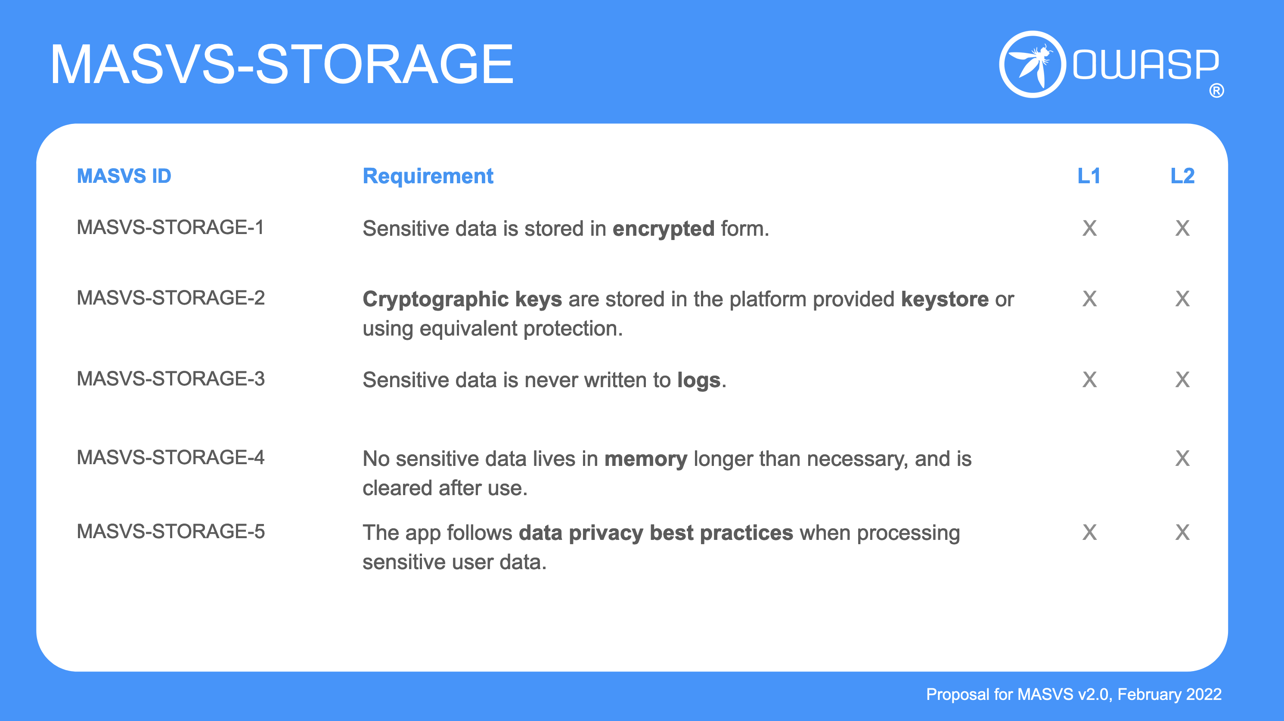
MASVS Example

Slide 10
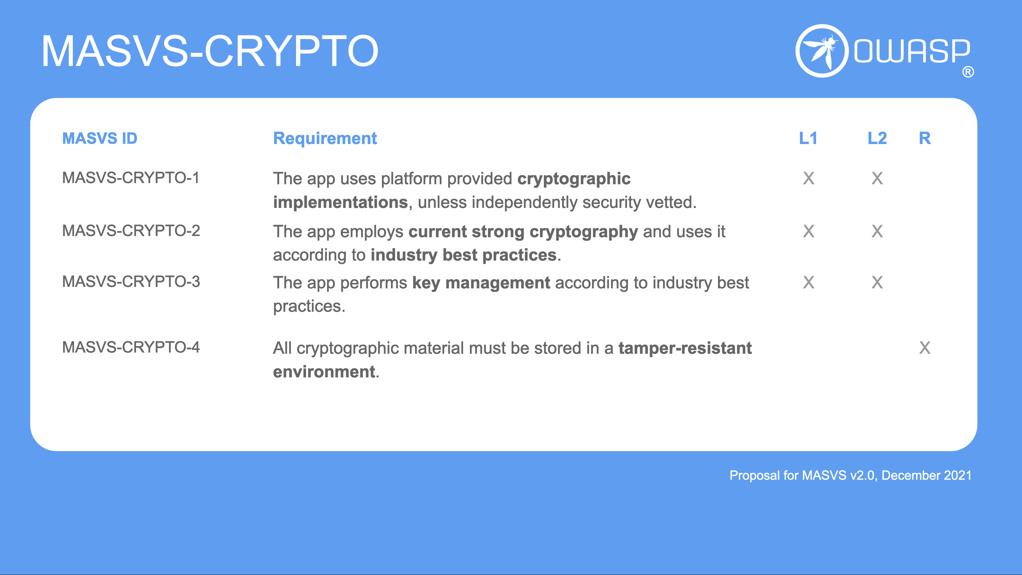
MASVS Example

Slide 11
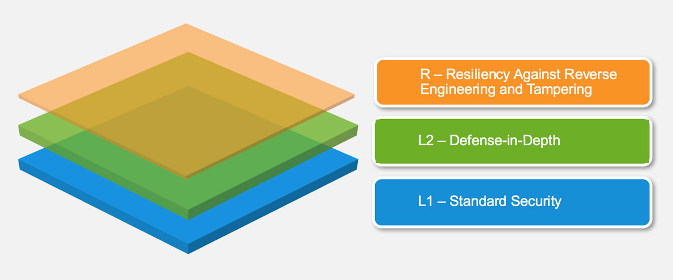
MASVS Verification Layers

Slide 12
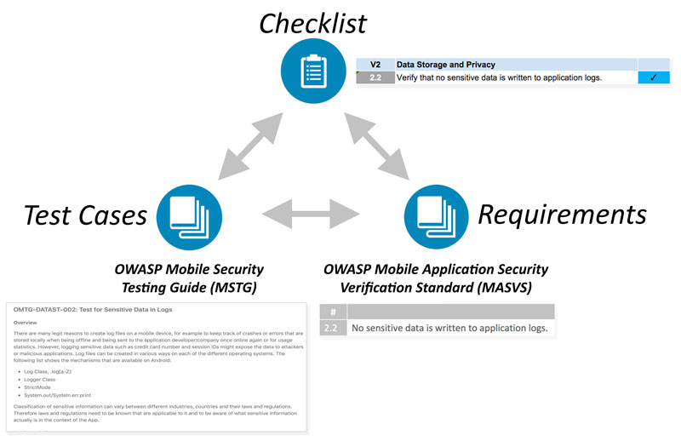
Mobile Security Testing Guide (MSTG)
The MSTG is a comprehensive manual for mobile app security testing and reverse engineering from OWASP.
MSTG describes technical processes for verifying the controls listed in the OWASP Mobile Application Verification Standard (MASVS).

Slide 13
MSTG: Key Areas in Mobile Security
Almost every mobile app talks to a backend service, and those services are prone to the same types of attacks we are familiar with in web apps on desktop machines.
MSTG breakdown 6 key areas in mobile app security:
Local Data Storage
Communication with Trusted Endpoints
Authentication and Authorization
Interaction with Mobile Platform
Code Quality and Exploit Mitigation
Anti-Tampering and Anti-Reversing

Slide 14
Local Data Storage
The protection of sensitive data, such as user credentials and private information, is crucial to mobile security.
If an app uses operating system APIs such as local storage or inter-process communication (IPC) improperly, the app might expose sensitive data to other apps running on the same device.
Henceforth, when developing mobile apps, we must take extra care when storing user data.
For example, we can use appropriate key storage APIs and take advantage of hardware-backed security features when available.

Slide 15
Local Data Storage on Android
Android provides a number of methods for data storage depending on the needs of the user, developer, and application, such as:
Shared Preferences
SQLite Databases
Firebase Databases
Realm Databases
Internal Storage
External Storage
Keystore
It is important to understand each relevant data storage function in order to correctly perform the appropriate test cases.

Slide 16
Communication with Trusted Endpoints
Mobile devices regularly connect to a variety of networks, including public Wi-Fi networks shared with other (potentially malicious) clients.
This creates opportunities for a wide variety of network-based attacks ranging from simple to complicated and old to new.
It's crucial to maintain the confidentiality and integrity of information exchanged between the mobile app and remote service endpoints.
As a basic requirement, mobile apps must set up a secure, encrypted channel for network communication using the TLS protocol with appropriate settings.

Slide 17
Communication with Trusted Endpoints
Testing Endpoint Identify Verification with Static Analysis
Verifying the Server Certificate
TrustManager is a means of verifying conditions necessary for establishing a trusted connection in Android.
The following conditions should be checked at this point:
Has the certificate been signed by a trusted CA?
Has the certificate expired?
Is the certificate self-signed?
WebView Server Certificate Verification
Sometimes applications use a WebView to render the website associated with the application.
When a WebView is used, the mobile browser performs the server certificate validation. Ignoring any TLS error that occurs when the WebView tries to connect to the remote website is a bad practice.

Slide 18
Authentication and Authorization
In most cases, sending users to log in to a remote service is an integral part of the overall mobile app architecture.
Even though most of the authentication and authorization logic happens at the endpoint, there are also some implementation challenges on the mobile app side.
Unlike web apps, mobile apps often store long-time session tokens that are unlocked with user-to-device authentication features such as fingerprint scanning.
While this allows for a quicker login and better user experience (nobody likes to enter complex passwords), it also introduces additional complexity and room for error.

Slide 19
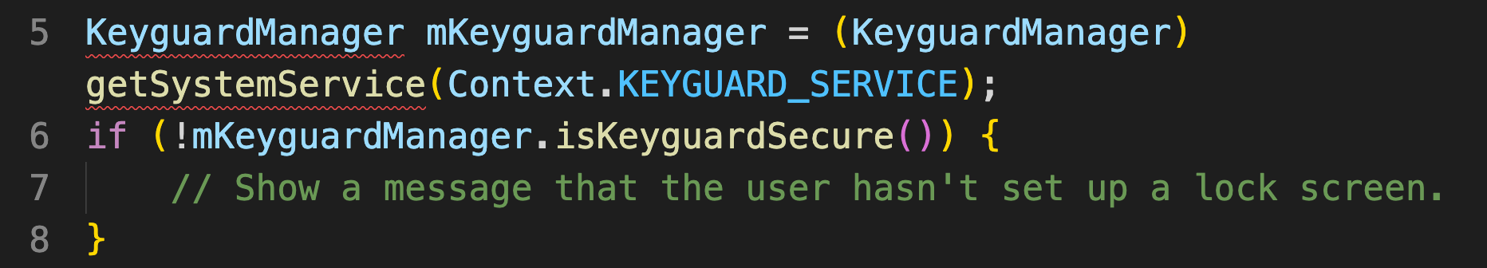
Testing Local Authentication on Android
Testing Confirm Credentials
The confirm credential flow is available since Android 6.0 and is used to ensure that users do not have to enter app-specific passwords together with the lock screen protection.
Instead: if a user has logged in to the device recently, then confirm-credentials can be used to unlock cryptographic materials from the AndroidKeystore.
That is, if the user unlocked the device within the set time limits (setUserAuthenticationValidityDurationSeconds), otherwise the device needs to be unlocked again.
Snippet to confirm that lock screen has been set

Slide 20
Interaction with Mobile Platform
Mobile operating system architectures differ from classical desktop architectures in important ways.
For example, all mobile operating systems implement app permission systems that regulate access to specific APIs.
They also offer more (Android) or less rich (iOS) inter-process communication (IPC) facilities that enable apps to exchange signals and data.
These platform-specific features come with their own set of pitfalls.
For example, if IPC APIs are misused, sensitive data or functionality might be unintentionally exposed to other apps running on the device.

Slide 21
Code Quality and Exploit Mitigation
Traditional injection and memory management issues aren't often seen in mobile apps due to the smaller attack surface.
Mobile apps mostly interact with the trusted backend service and the UI, so even if many buffer overflow vulnerabilities exist in the app, those vulnerabilities usually don't open up any useful attack vectors.
The same applies to browser exploits such as cross-site scripting (XSS allows attackers to inject scripts into web pages) that are very prevalent in web apps.
However, there are always exceptions. XSS is theoretically possible on mobile in some cases, but it's very rare to see XSS issues that an individual can exploit.

Slide 22
Anti-Tampering and Anti-Reversing
There are three things you should never bring up in polite conversations: religion, politics, and code obfuscation.
Many security experts dismiss client-side protections outright.
However, software protection controls are widely used in the mobile app world, so security testers need ways to deal with these protections.
We believe there's a benefit to client-side protections if they are employed with a clear purpose and realistic expectations in mind and aren't used to replace security controls.

Slide 23
MSTG Key Areas in relation to Specific Android Testing
Key Areas | Specific Android Testing
Local Data Storage | Data Storage on Android
Communication with Trusted Endpoints | Cryptographic APIs Android Network APIs
Authentication and Authorization | Local Authentication on Android Cryptographic APIs
Interaction with Mobile Platform | Cryptographic APIs
Code Quality and Exploit Mitigation | Code Quality and Build Settings for Android Apps
Anti-Tampering and Anti-Reversing | Tampering and Reverse Engineering on Android Android Anti-Reversing Defenses

Slide 24
References
Chell, D., Erasmus, T., Colley, S., & Whitehouse, O. (2015). The mobile application hacker's handbook. John Wiley & Sons.
https://mobile-security.gitbook.io/masvs/
https://mobile-security.gitbook.io/mobile-security-testing-guide/
COMP6047 - Algorithm and Programming

